Slide 1

21ECSC210
Exploratory Data Analysis Course Project: ESA
DATA DRIVEN INSIGHTS INTO ANXIETY DISORDERS
Department of Computer Science and Engineering,
KLE Technological University’s Dr. M. S. Sheshgiri College of Engineering and Technology, Belagavi

Slide 2
Details of the Team
Div: |  | A
Sl. No. | Name |  | SRN.
1 | CHANDNI KUMARI |  | 02FE22BCS026
2 | PRASHANT UPPAR |  | 02FE22BCS069
3 | WILFRED BORGES |  | 02FE22BCS177
4 | YUKTA H SANNAKKI |  | 02FE22BCS179
Department of Computer Science and Engineering,
KLE Technological University’s Dr. M. S. Sheshgiri College of Engineering and Technology, Belagavi

Slide 3


Introduction
Anxiety disorders are common mental health problems that seriously affect people's lives. Predicting these disorders early provide timely support and treatment. This project explores how Exploratory Data Analysis (EDA) and cleaning to help make better analysis of anxiety levels. We studied different methods for handling missing data, feature scaling, and data visualization using one well- known anxiety disorder dataset. Our goal is to explore how gaming-related anxiety affects individuals, identify the signs, and find ways to manage and reduce this anxiety. By doing so, we hope to help people enjoy gaming responsibly without compromising their health and well- being. The goal analyze and understand Trends
Department of Computer Science and Engineering,
KLE Technological University’s Dr. M. S. Sheshgiri College of Engineering and Technology, Belagavi

Slide 4
Problem Statement and Objectives
PROBLEM STATEMENT:
"Develop a predictive model to assess the level of narcissism in students based on their activities, mental health, and other influencing factors."
OBJECTIVES:
1. Doing preprocessing
2. Visualizing the trends and patterns
3. Drawing inferences
Department of Computer Science and Engineering,
KLE Technological University’s Dr. M. S. Sheshgiri College of Engineering and Technology, Belagavi

Slide 5

SDG3 and its targets
Goal 3: “To ensure healthy lives and promote well-being for all at all ages.”
SDG 3 focuses on ensuring healthy lives and promoting well-being for all. The targets of SDG 3 focus on various aspects of healthy life and healthy lifestyle.
TARGETS:
SDG 3 has 13 targets and 28 indicators to measure progress toward targets.
1. reducing maternal mortality
2. ending all preventable deaths under five years of age
3. fighting communicable diseases
4. reducing mortality from non-communicable diseases and promoting mental health
5. preventing and treating substance abuse
6. reducing road injuries and deaths
7. granting universal access to sexual and reproductive care, family planning and education
8. achieving universal health coverage
9. reducing illnesses and deaths from hazardous chemicals and pollution.
10. implementing the WHO Framework Convention on Tobacco Control
11. supporting research, development, and universal access to affordable vaccines and medicines
12. increasing health financing and support the health workforce in developing countries
13. improving early warning systems for global health risks.
Department of Computer Science and Engineering,
KLE Technological University’s Dr. M. S. Sheshgiri College of Engineering and Technology, Belagavi

Slide 6
SDG3 and its targets
Choosing to analyze anxiety disorders related to gaming aligns perfectly with Sustainable Development Goal 3.4, which aims to promote mental health and well-being. The rapid growth of the gaming industry has brought about both positive and negative impacts, with rising concerns about gaming addiction and its psychological repercussions. By focusing on this intersection, we can uncover crucial insights into how gaming influences anxiety levels, ultimately contributing to more informed mental health strategies. This analysis not only highlights the importance of addressing modern mental health challenges but also underscores the necessity of fostering a balanced approach to digital consumption.
Department of Computer Science and Engineering,
KLE Technological University’s Dr. M. S. Sheshgiri College of Engineering and Technology, Belagavi

Slide 7
Objectives
1.Understanding the data related to target variable(Narcissism)..
2. Understanding methods of preprocessing, visualization and model fitting.
3. Understanding the trends of each attributes of each variable towards target variable.
4. Understanding the relationship between the attributes with transitivity property.
5. Analyzing the level of Narcissism related to the each students.
Department of Computer Science and Engineering,
KLE Technological University’s Dr. M. S. Sheshgiri College of Engineering and Technology, Belagavi

Slide 8
Dataset Details
This dataset presents a comprehensive collection of data that sheds light on the intricate landscape of anxiety experienced by students. The dataset proposes a social health challenge on Kaggle uploaded on Kaggle few years ago.
There are 13000+ instances in this dataset.
It also includes 55 attributes.
The source of this data set is Kaggle:
https://www.kaggle.com/datasets/petalme/student-anxiety-dataset
Department of Computer Science and Engineering,
KLE Technological University’s Dr. M. S. Sheshgiri College of Engineering and Technology, Belagavi

Slide 9
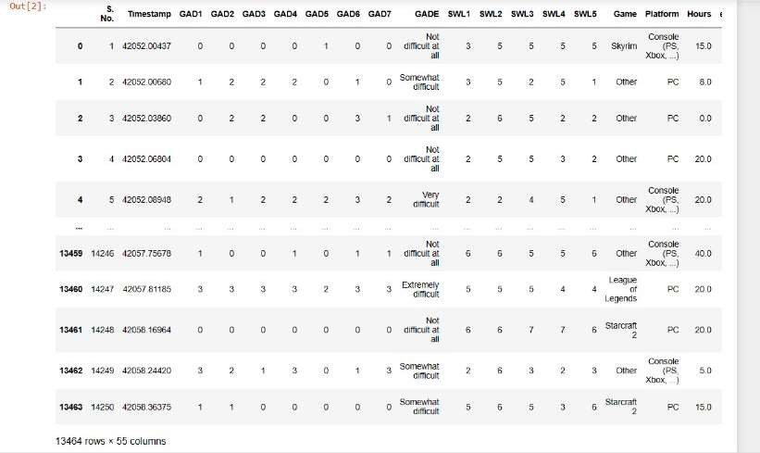
Dataset Details
Snapshot of the CSV file.
Department of Computer Science and Engineering,
KLE Technological University’s Dr. M. S. Sheshgiri College of Engineering and Technology, Belagavi

Slide 10
Knowing the Dataset
Short description about the attributes of the dataset.
1,GAD(Generalized anxiety disorder) : Mental health condition characterized by persistent and excessive worry or anxiety about a wide range of everyday things.
2.GADE : To look at (level of difficulty).
3.SWL(Satisfaction with life) : This refers to an individual’s self-reported evaluation of their own wellbeing, encompassing factors such as life satisfaction, positive emotions and sense of purpose.
4.Game : Name of a game patient used to play that led to issues.
5.Platform :Refers to a digital or physical environment where individuals can engage in playing video games.
6.Hours : Time Duration of game played.
7.Earnings : refers to the income or profits generated by individual through game .
Department of Computer Science and Engineering,
KLE Technological University’s Dr. M. S. Sheshgiri College of Engineering and Technology, Belagavi

Slide 11
8.Whyplay : Reason to play the game
9.League : Earn in-game currency and experience points by participating in game.
10.Highest League : refers to the top division or tier within a ranking system of the game.
11.Streams : Often refers to live broadcasts of video game play by an individual.
12.SPIN : Feeling mentally unclear or confused.
13.Narcissism : Mental health condition in which patient have an unreasonably high sense of their own importance.
14.Gender : Gender of the participant.
15.Age : Age of the participant.
Department of Computer Science and Engineering,
KLE Technological University’s Dr. M. S. Sheshgiri College of Engineering and Technology, Belagavi

Slide 12
16.Work : Employment status or occupation of the participant.
17.Degree : Educational degree attained by the participant.
18.Birth Place : Place of birth of the participant.
19.Reference : Source of reference or how the participant was recruited.
20.Playstyle : Style or approach to gaming by the participant.
21.Accept : Acceptance of the gaming lifestyle or culture of the participant.
22.GAD_T : Total score or evaluation from the Generalized Anxiety Disorder assessment.
23.SWL_T : Total score or evaluation from the Satisfaction with Life scale.
24.SPIN_T : Total score or evaluation from the SPIN scale.
Department of Computer Science and Engineering,
KLE Technological University’s Dr. M. S. Sheshgiri College of Engineering and Technology, Belagavi

Slide 13
Feature Set Description
Numeric Attributes:
1.GAD(Generalized anxiety disorder)
2.GADE
3.SWL(satisfaction with life)
4.Earnings
5.Age
6.GAD_T
7.SWL_T
8.SPIN_T
Department of Computer Science and Engineering,
KLE Technological University’s Dr. M. S. Sheshgiri College of Engineering and Technology, Belagavi

Slide 14
Categorical Attributes:
1.Game
2.Platform
3.Whyplay
4.League
5.Highest league
6.Streams
7.SPIN
8.Narcissism
9.Gender
10.Work
11.Degree
12.Birth palce
13.Reference
14.Playstyle
15.Accept
Department of Computer Science and Engineering,
KLE Technological University’s Dr. M. S. Sheshgiri College of Engineering and Technology, Belagavi

Slide 15
Domain Understanding:
Anxiety disorder is a mental health condition characterized by persistent and excessive worry or fear about everyday situations. It encompasses various forms, such as generalized anxiety disorder (GAD), panic disorder, social anxiety disorder, and specific phobias, each presenting unique symptoms and triggers. Individuals with anxiety disorders often experience intense, prolonged periods of anxiety that interfere with daily activities, leading to physical symptoms like increased heart rate, sweating, and fatigue, as well as cognitive symptoms like difficulty concentrating and irrational fear. The disorder is influenced by a combination of genetic, environmental, and psychological factors, and it can be effectively managed through therapy, medication, and lifestyle changes.
Department of Computer Science and Engineering,
KLE Technological University’s Dr. M. S. Sheshgiri College of Engineering and Technology, Belagavi

Slide 16
Data Pre-processing
Data Cleaning: Handle missing values, correct errors, and remove duplicates.
Data Transformation: Standardize/ normalize data, convert data types, and apply mathematical transformations.
Feature Engineering: Create new features to enhance model performance.
Encoding Categorical Variables: Convert categorical data to numerical using one-hot or label encoding.
Handling Outliers: Identify and treat outliers to prevent skewing analysis.
Data Integration: Combine data from multiple sources for a comprehensive dataset.
Data Reduction: Simplify datasets using dimensionality reduction or feature selection.
Scaling and Normalization: Ensure features have comparable scales for sensitive algorithms.
Department of Computer Science and Engineering,
KLE Technological University’s Dr. M. S. Sheshgiri College of Engineering and Technology, Belagavi

Slide 17
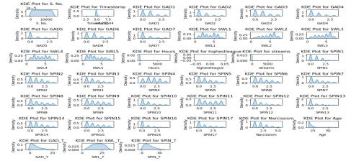
Data Pre-processing
A. Data Distribution
The data distribution of our dataset :
Uniform: Timestamp
Positively Skewed: ( GAD1 - GAD7 ) , ( SWL1 - SWL5 ) , (SPIN1- SPIN17), Narcissism, Age, GAD_T.
Normally distributed: SPIN_T
From the above figure, we understand that most of the attributes are positively skewed.
Department of Computer Science and Engineering,
KLE Technological University’s Dr. M. S. Sheshgiri College of Engineering and Technology, Belagavi

Slide 18
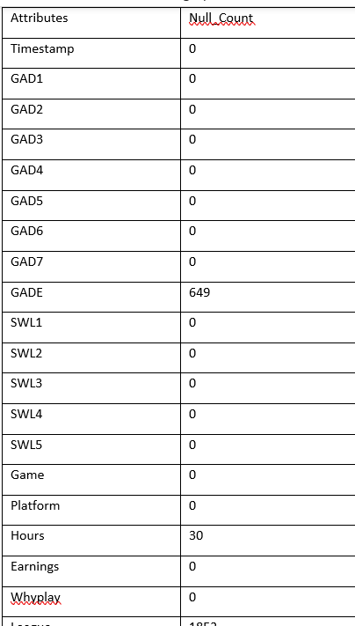
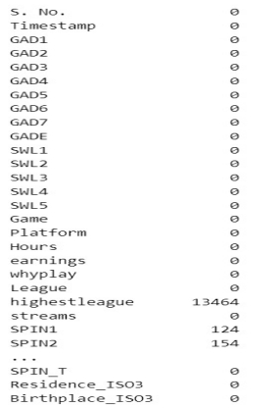
Data Pre-processing
B. Handling Missing values
An essential step in data pre-processing is the correction of inaccurate and incorrect data within the dataset. Handling missing values appropriately is crucial and the optimal approach depends on the specific dataset and the desired outcomes. Several fundamental techniques are commonly employed to address missing values:
Before handling missing values.
After handling missing values.
Department of Computer Science and Engineering,
KLE Technological University’s Dr. M. S. Sheshgiri College of Engineering and Technology, Belagavi

Slide 19
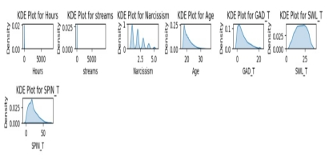
Data Pre-processing
The data distribution of our dataset after handling missing values
From the above figure, we understand that the distribution is mostly unaffected.
Department of Computer Science and Engineering,
KLE Technological University’s Dr. M. S. Sheshgiri College of Engineering and Technology, Belagavi

Slide 20
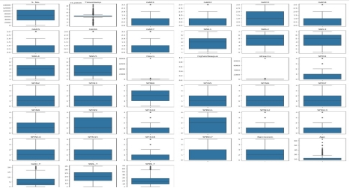
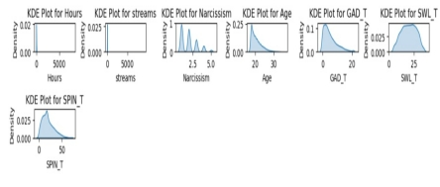
Data Pre-processing
C. Handling Outliers
Box plot before removing outliers After removing outliers
After removing outliers, there are some attributes with outliers as shown in above figure and we can’t remove or fill with null values, it will change the trend of our data. So, we are keeping these attributes as it is, if we fill it with null values, it will lead to overfitting of data.
Department of Computer Science and Engineering,
KLE Technological University’s Dr. M. S. Sheshgiri College of Engineering and Technology, Belagavi

Slide 21
Data Pre-processing
D. Data Transformation
Most machine learning model cannot work with categorical data in a text form. We encode most of the categorical features using Ordinal Encoding because most of them have meaningful ranking in the data set and Nominal encoding for feature without meaningful ranking.
We replace the data using ordinal encoding i.e 2>1>0.
Work | No. assigned
Employed | 0
Student at college / University | 1
Student at school | 2
Unemployed / between jobs | 3
:
Platform Used | No.assigned
Console | 0
PC | 1
Smartphone or Tablet | 2
Gender | No. assigned
Female | 0
Male | 1
Other | 2
Department of Computer Science and Engineering,
KLE Technological University’s Dr. M. S. Sheshgiri College of Engineering and Technology, Belagavi

Slide 22
Data Pre-processing
Name of game | No. assigned
Counter strike | 0
Destiny | 1
Diablo3 | 2
Guild war2 | 3
Heart stone | 4
Heroes of strom | 5
League of legends | 6
Other | 7
Skyrm | 8
Starcraft | 9
World of warcraft | 10
Playstyle | No. assigned
Multiplayer offline people in the same room | 0
Multiplayer online with online acquintances or teammates | 1
Multiplayer online with real life friends | 2
Multiplayer online with strangers | 3
singleplayer | 4
Ranking | No. assigned
Bronze | 0
Challenger | 1
Diamond | 2
Gold | 3
Master | 4
Platinum | 5
Silver | 6
Unranked | 7
Unspecified | 8
Game:
Fig.:Table3
Platform:
:
Department of Computer Science and Engineering,
KLE Technological University’s Dr. M. S. Sheshgiri College of Engineering and Technology, Belagavi

Slide 23
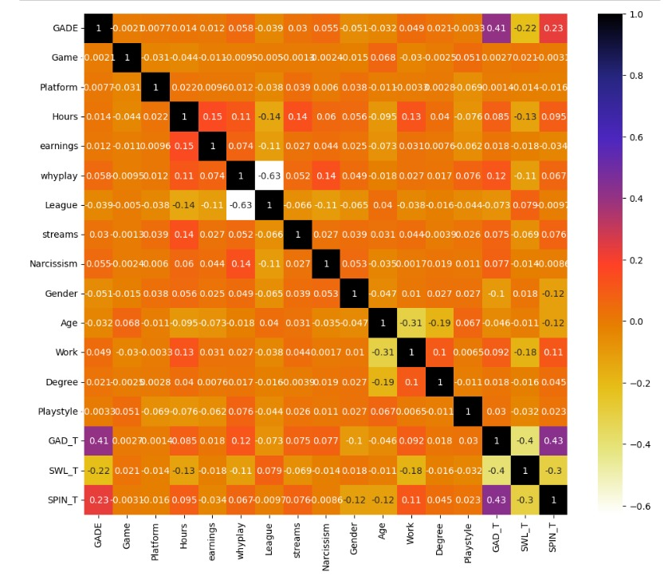
Data Pre-processing
E. Correlation Matrix
The correlation coefficient ranges from-1 to 1.
1 represents positive correlation.
-1 represents negative correlation.
0 means no correlation.
Color represents correlation values.
Higher the color, stronger the correlation.
* we analyzed that Streams and Hours have high correlation(Positive) . And SPIN and SWL have less correlation(Negative).
Department of Computer Science and Engineering,
KLE Technological University’s Dr. M. S. Sheshgiri College of Engineering and Technology, Belagavi

Slide 24
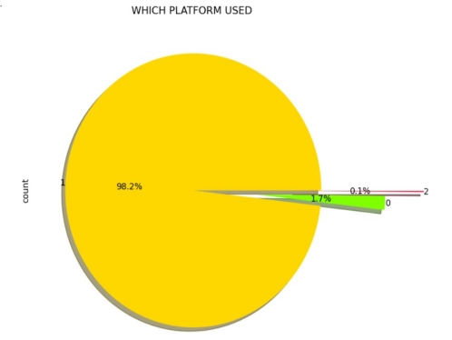
Proposed Hypotheses
Which platform is more used by players?
INFERENCE:
We can say that the mostly used platform is 1(i.e PC)
Department of Computer Science and Engineering,
KLE Technological University’s Dr. M. S. Sheshgiri College of Engineering and Technology, Belagavi

Slide 25
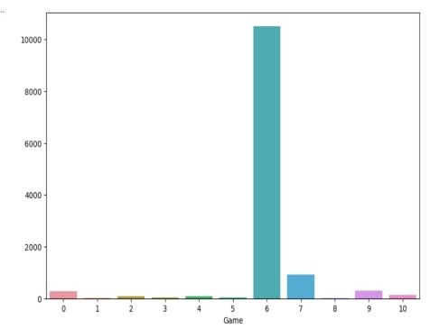
2. Which is mostly played game?
INFERENCE:
we can say that the mostly played game is 6(i.e.League of legends).
Department of Computer Science and Engineering,
KLE Technological University’s Dr. M. S. Sheshgiri College of Engineering and Technology, Belagavi

Slide 26
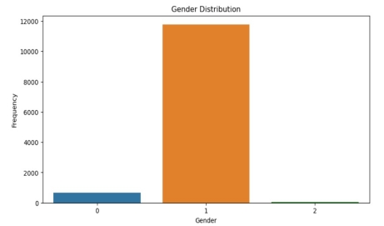
3. How gender is distributed?
INFERENCE:
we can say that the players who are playing game are mostly males(1).
Department of Computer Science and Engineering,
KLE Technological University’s Dr. M. S. Sheshgiri College of Engineering and Technology, Belagavi

Slide 27
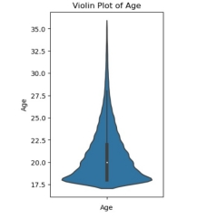
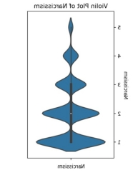
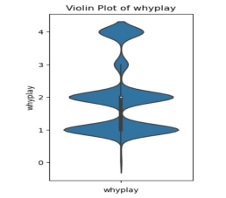
Violin plot for the univariate analysis:
INFERENCE:
we can infer that Students playing game are near to age 20 and Narcissism level is 1 and majority players are playing game for fun.
Department of Computer Science and Engineering,
KLE Technological University’s Dr. M. S. Sheshgiri College of Engineering and Technology, Belagavi

Slide 28
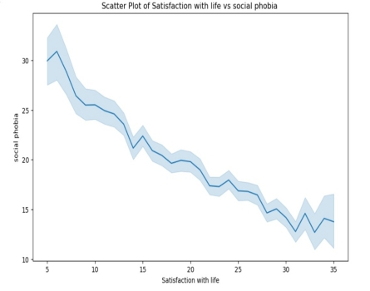
Bivariate Analysis :
4. How satisfaction with life is related with social phobia?
INFERENCE:
We can say that social phobia and satisfaction with life is inversely proportional to each other. As social phobia increases satisfaction with life decreases.
Department of Computer Science and Engineering,
KLE Technological University’s Dr. M. S. Sheshgiri College of Engineering and Technology, Belagavi

Slide 29
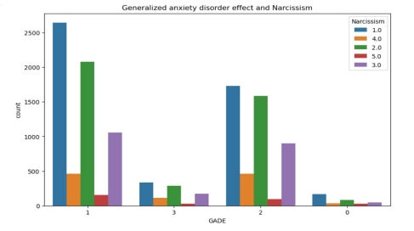
5. How Narcissism will affect the generalized anxiety disorder effect on students?
INFERENCE:
we can say that anxiety disorder not at all difficult with Narcissism level of 1.
Department of Computer Science and Engineering,
KLE Technological University’s Dr. M. S. Sheshgiri College of Engineering and Technology, Belagavi

Slide 30
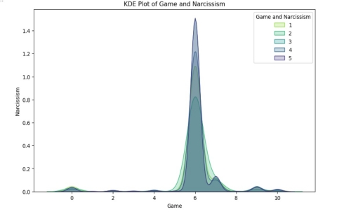
6. How Narcissism will affect the game played by students?
INFERENCE:
we can say that majority of the players plays league of legends with Narcissism level of 3.
Department of Computer Science and Engineering,
KLE Technological University’s Dr. M. S. Sheshgiri College of Engineering and Technology, Belagavi

Slide 31
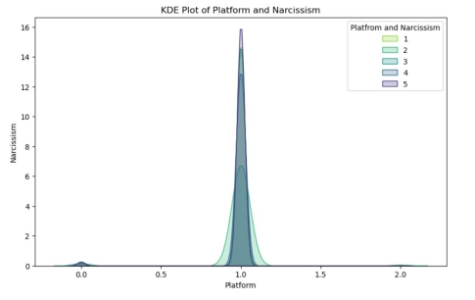
7. How Narcissism will affect the platform used for gaming?
INFERENCE:
We can say that majority of the students plays on the PC(1) with Narcissism level of 2.
Department of Computer Science and Engineering,
KLE Technological University’s Dr. M. S. Sheshgiri College of Engineering and Technology, Belagavi

Slide 32
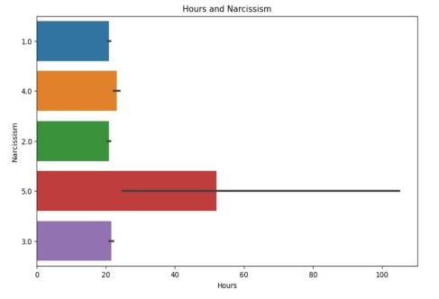
8. How Narcissism will affect the no. of hours spent playing game?
INFERENCE:
we can say that as no. of playing hours increases Narcissism level also increases
Department of Computer Science and Engineering,
KLE Technological University’s Dr. M. S. Sheshgiri College of Engineering and Technology, Belagavi

Slide 33
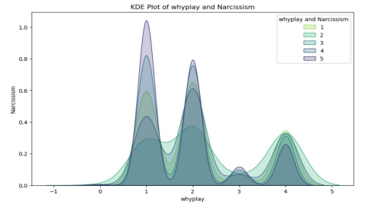
9. How Narcissism will affect the whyplay of the game by students?
INFERENCE:
we can say that most of the students playing game for fun, improving and winning with narcissism level of 2.
Department of Computer Science and Engineering,
KLE Technological University’s Dr. M. S. Sheshgiri College of Engineering and Technology, Belagavi

Slide 34
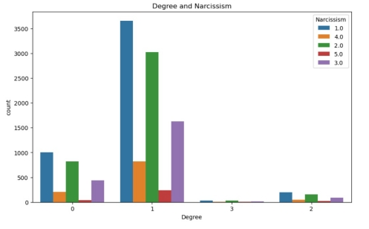
10. How degree is related to Narcissism?
INFERENCE:
We can say that majority of the players have degree high school diploma with narcissism level 1.
Department of Computer Science and Engineering,
KLE Technological University’s Dr. M. S. Sheshgiri College of Engineering and Technology, Belagavi

Slide 35
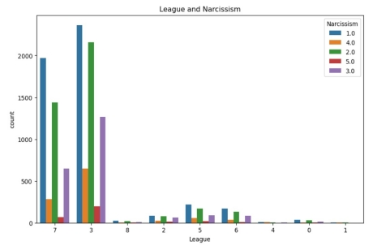
11. How Narcissism will affect the League?
INFERENCE:
we can say that most of the students got gold, platinum and some are unranked with an average narcissism level of 3.
Department of Computer Science and Engineering,
KLE Technological University’s Dr. M. S. Sheshgiri College of Engineering and Technology, Belagavi

Slide 36
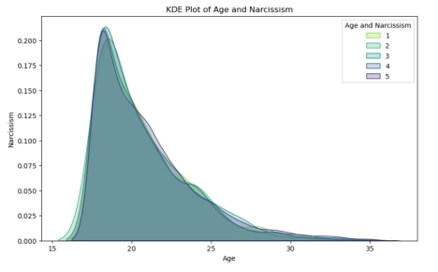
12. How age is related to Narcissism?
INFERENCE:
we can infer that majority of the students playing game are near to age 20 with narcissism level of 2&4.
Department of Computer Science and Engineering,
KLE Technological University’s Dr. M. S. Sheshgiri College of Engineering and Technology, Belagavi

Slide 37
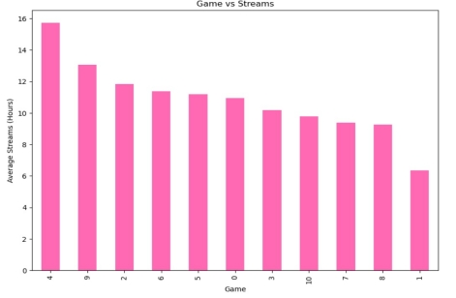
13. Which is most streamed game based on hours?
INFERENCE:
we can say that students playing heart stone spent more time in live streaming
Department of Computer Science and Engineering,
KLE Technological University’s Dr. M. S. Sheshgiri College of Engineering and Technology, Belagavi

Slide 38
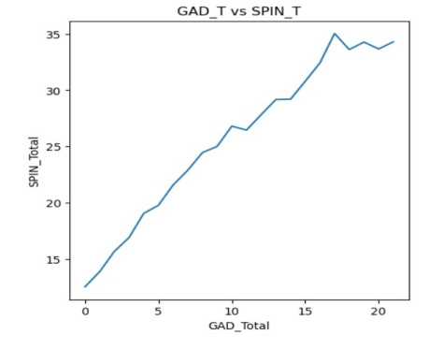
14. How generalized anxiety disorder is related to social phobia?
INFERENCE:
we can say that generalized anxiety disorder is directly proportion to each other and having high positive correlation.
Department of Computer Science and Engineering,
KLE Technological University’s Dr. M. S. Sheshgiri College of Engineering and Technology, Belagavi

Slide 39
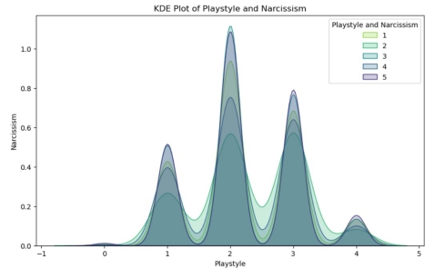
15. How Narcissism is affected by playstyle?
INFERENCE:
We can say that most of the players plays online with friends and strangers with narcissism level of 2.
Department of Computer Science and Engineering,
KLE Technological University’s Dr. M. S. Sheshgiri College of Engineering and Technology, Belagavi

Slide 40
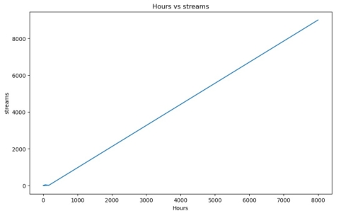
16. How no. of hours related to no of hours streamed?
INFERENCE:
we can infer that the no. of hours is directly proportional to no. of hours streamed.
Department of Computer Science and Engineering,
KLE Technological University’s Dr. M. S. Sheshgiri College of Engineering and Technology, Belagavi

Slide 41
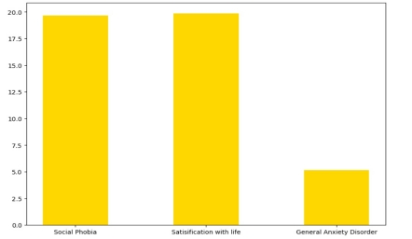
17. How social phobia(SPIN), satisfaction with life(SWL) and generalized anxiety disorder(GAD) is distributed?
INFERENCE:
we can infer that no. of students with social phobia, satisfaction with life is same as compared with generalized anxiety disorder.
Department of Computer Science and Engineering,
KLE Technological University’s Dr. M. S. Sheshgiri College of Engineering and Technology, Belagavi

Slide 42
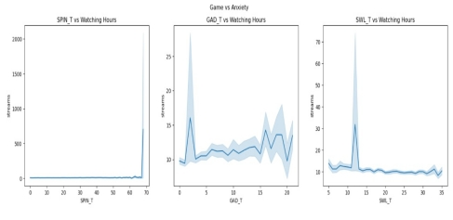
18. How SWL_T, SPIN_T and GAD_T will be affected by the no. of hours played?
INFERENCE:
we are not getting any inferences.
Department of Computer Science and Engineering,
KLE Technological University’s Dr. M. S. Sheshgiri College of Engineering and Technology, Belagavi

Slide 43
Conclusion
In our project, we understood the importance of Exploratory Data Analysis (EDA) and data pre-processing for analyzing anxiety levels. By carefully handling missing values, outliers, and noise, and applying appropriate imputation and scaling techniques, the quality of the data can be significantly improved, which is crucial for accurate results.
In our project, we focused on understanding the data and forming hypotheses rather than building machine learning models. We explored different methods for dealing with missing values and outliers, and we examined how these pre-processing techniques can impact the data. We analyzed that the majority of the players suffering from anxiety are students as they are spending more time to play games on PC. Our analysis provided insights into the relationships between various features and the target variable(Narcissism), which is essential for developing robust prediction models in the future.
Department of Computer Science and Engineering,
KLE Technological University’s Dr. M. S. Sheshgiri College of Engineering and Technology, Belagavi

Slide 44
Thank you !
Questions and Answers
Department of Computer Science and Engineering,
KLE Technological University’s Dr. M. S. Sheshgiri College of Engineering and Technology, Belagavi

